Slide 1
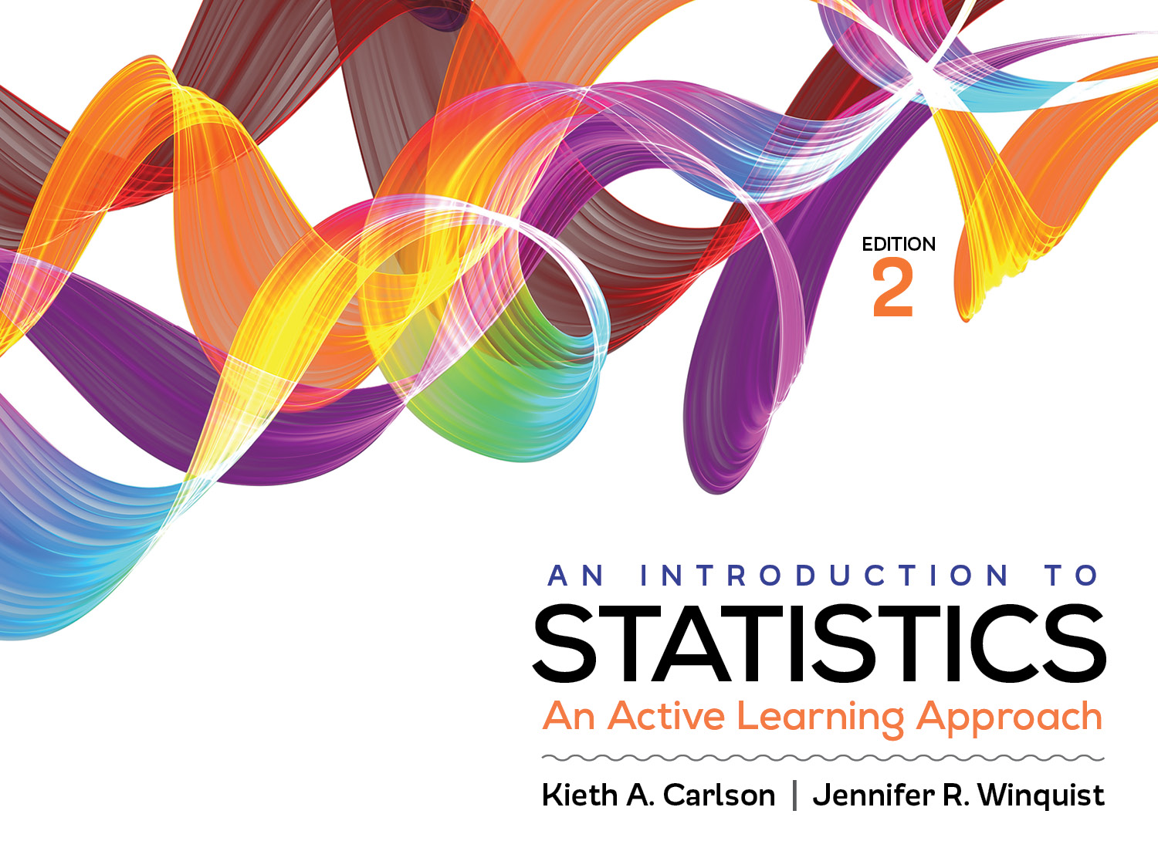
Introduction to Activity 6.2
Critical values, p values, and the null hypothesis

Slide 2
Activity 6.2 will require you to:
Describe what a p value represents
Describe the relationship between critical values, p values, and the null hypothesis

Slide 3
Distribution of sample means
A frequency distribution of all possible sample means if the null hypothesis is true
Common sample means are near zero; rare sample means are near the tails

Slide 4
Critical value, critical region, and alpha value
The critical value starts the critical region; it is set by the alpha value.
If alpha is .05, the critical value is 1.65 (or -1.65); see Appendix A.
The size of the critical region is always equal to alpha (e.g., size is 5% of curve if alpha is .05).
1.65 or higher is the critical region

Slide 5
Critical value, critical region, and alpha value
The critical region represents possible but unlikely results if the null hypothesis is true
1.65 or higher is the critical region

Slide 6
Obtained value and p value
The obtained value is computed from the data (result from z formula)
An obtained value of 2.0 has a probability of .0228 if the null is true; see Appendix A.
.0228 is the p value for the obtained value of 2.0.
5% of sample means are to the right of the critical value
2.28% of sample means are to the right of the obtained value

Slide 7
Obtained value and p value
The p value is the probability of getting the obtained value if the null hypothesis is true.
Getting an obtained value of 2.0 if the null is true is possible, but it will rarely happen; only 2.88% of the time due to sampling error.
5% of sample means are to the right of the critical value
2.28% of sample means are to the right of the obtained value

Slide 8
Can you answer these questions?
What does a p value represent?
What does a critical region represent?
What is an obtained value?

Slide 9
Helpful hints
We will be using critical values, alpha values, obtained values, and p values for the rest of the semester.
It is worth your time to learn what each of these concepts is and how they are related to each other.
Try explaining how you use each of these is to someone next to you.

